Slide 1
Movie Data Analysis
Jaden Lin
Notes:
Hi I'm Jaden and this is my mod 1 project presentation on Movie Data Analysis

Slide 2
What factors go into a successful movie?
How well it is received by an audience? ( Rating)
How popular is it? (Popularity Score)
How much profit it brings in? ( Gross)
Does a bigger budget bring in more gross?
What is the most popular genre?
What is the highest grossing genre?
Notes:
First we begin by defining what makes a movie "successful"
These are question that we must consider

Slide 3
Process
Web scraped 150 movie titles per year for the past 3 decades
Pass all 4500 titles to TMDB API
Inserting all viable data into a CSV
Exploratory Data Analysis
Results

Slide 4

Dataset Information
Top 150 titles of every year for to past 3 decades (1990-2019)
4500 Total entries
Title
Budget
Domestic Gross
Popularity
Average Rating
Run Time

Slide 5
Notes:
Does a high budget bring in more money?
Not always, although we see a positive relationship we also see some low budget movies have the potential to exceeding higher budget movies in profit.
What i would reccommend is a budget of 45-55 million
This range is the average budget of all the movies in the past decade
didnt included movies before 2010 because of inflation

Slide 6
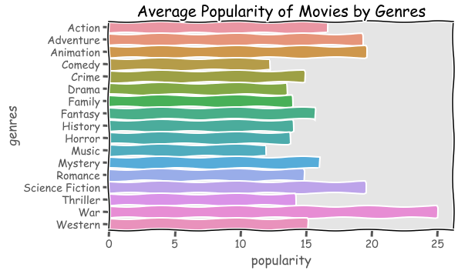
Notes:
Next I wanted to see what genres are the most popular.
base on our data Sci-fi is the most popular genre
followed by
war
animation
At this point I assuming that popularity equals to more profit, because popular movies have bigger fan bases and that would translate to more profit

Slide 7
Notes:
Now lets look at the average gross of each genre
to see if that true
Animation
Adventure
Family
Sci-Fi
Action
Base on the last graph we see and comparing it to this, we can tell that popularity doesn't in higher gross
the highest grossing genre is Animation and sci-fi is 4th

Slide 8
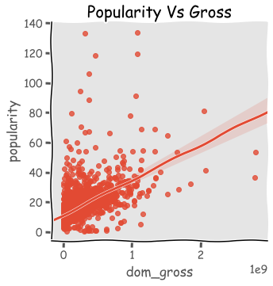
Notes:
Now lets look at the average gross of each genre
to see if that true
Animation
Adventure
Family
Sci-Fi
Action
Base on the last graph we see and comparing it to this, we can tell that popularity doesn't in higher gross
the highest grossing genre is Animation and sci-fi is 4th

Slide 9
Popularity or Profit?
Notes:
Typically movies arent just one specific genre,
its a mixture of them.
Base on my analysis an animation/sci-fi movie with a budget of 45-50 million is

